Slide 1
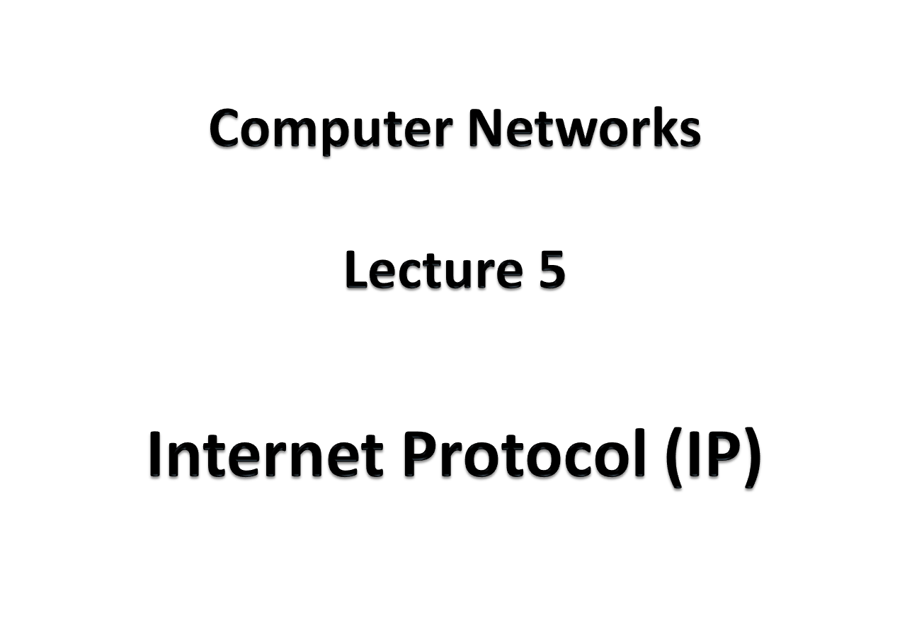

Slide 2
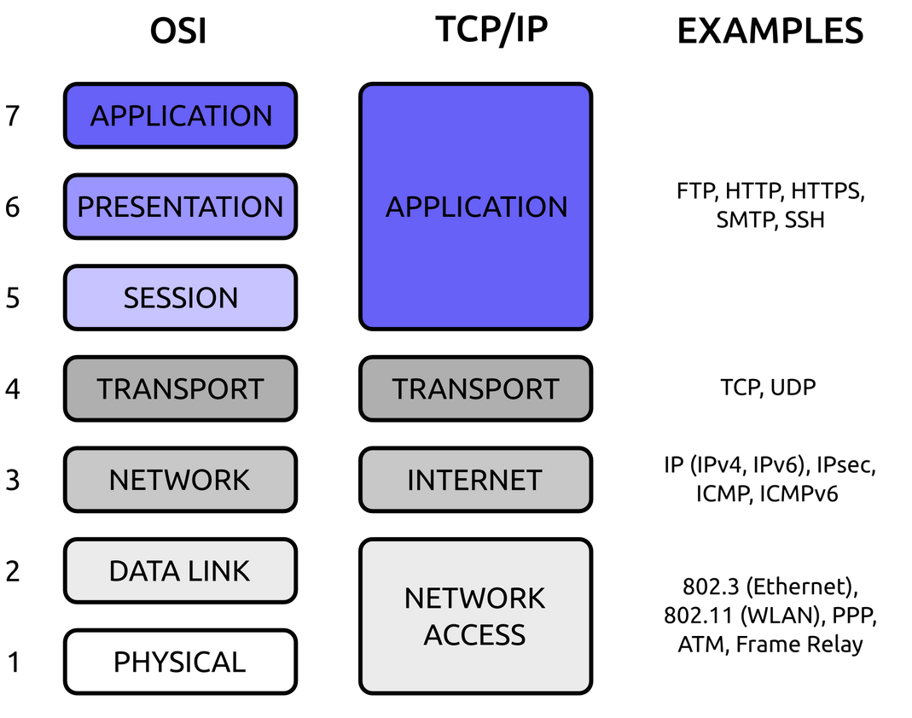


Slide 3
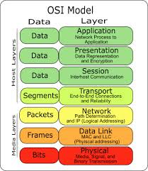

Slide 4
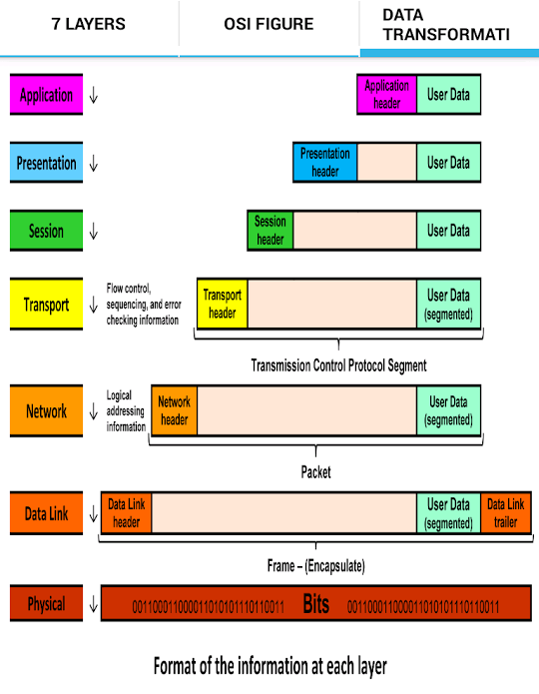

Slide 5
Overview of IP
IP is the network layer protocol of TCP/IP
No Error control, flow control and congestion control
Hence IP is an unreliable protocol
Combination TCP/IP is reliable
But UDP/IP is an unreliable combination
IP packets operate as datagram
IP packets originated from same source can travel through different routes and reach the destination at different times
Therefore IP packets may reach the destination out of order

Slide 6
Identification
Each IP packet is identified by a serial number called “Identification”
This sequence will be helpful to the receiver to reassemble the packets in the correct order, although they may receive in out of order

Slide 7
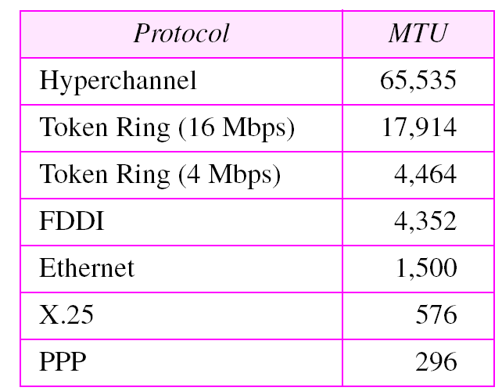
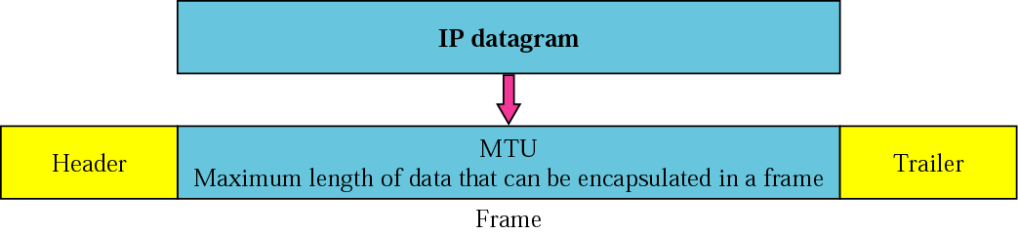
Maximum Transmission Unit (MTU)
Maximum amount of data that can be accommodated in a frame

Slide 8
Fragmentation
If the IP packet size is bigger than MTU, it should be fragmented
Ex : If the original packet has 6000 bytes of data
Separate data and Header of IP Packet
Break data part into MTUs (Fragments)
Add 20 byte header to each fragment

Slide 9
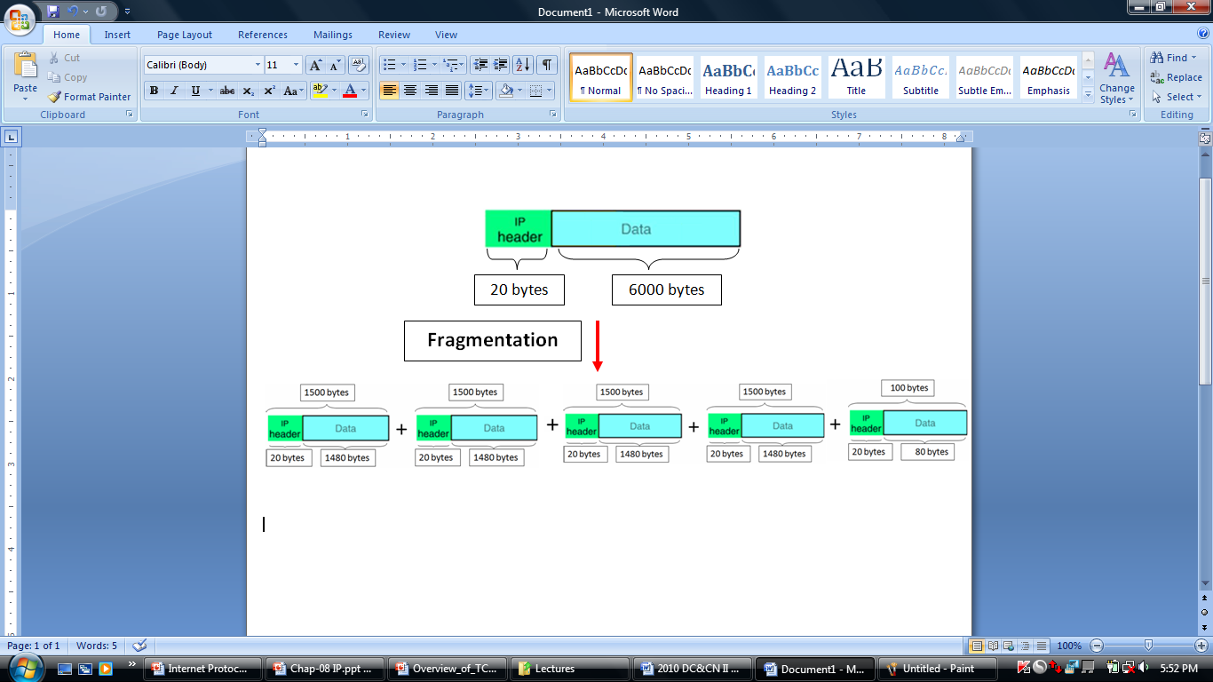

Slide 10
Fragmentation offset
The identification of each fragmented IP packet is equal to identification of original IP packet
Ex : If the identification of original IP packet is 2000,
identification of all five fragments is 2000
“ Fragmentation offset ” is an another parameter used to identity the order of fragments

Slide 11
Fragmentation offset cont.
If the original packet has 6000 bytes of data , the numbering of data bytes are as follows
Fragment 1
0
1479
Fragment 2
1480
2959
Fragment 3
2960
4439
Fragment 4
4440
5919
Fragment 5
5920
5999

Slide 12
Fragmentation offset cont.
Offset value of fragment 1 = 0 = 0 8
Offset value of fragment 2 = 1480 = 185 8
Offset value of fragments 3 = 2960 = 370 8
Offset value of fragment 4 = 4440 = 555 8
Offset value of fragment 5 = 5920 = 740 8

Slide 13
Fragmentation offset cont.
Fragmented packets travel independently
They may travel through different routes to the destination
While it is traveling it can be further fragmented at another intermediate network
Original Packet
Fragmented packets
Fragmented packets

Slide 14
Fragmentation offset cont.
Fragmented packets reach to the destination out of order.
The fragmented packets are combined (defragmented) at the final destination by using the OFFSET values.

Slide 15
Time To Live (TTL)
IP packets travel through many routers in the network
Each router routes the packet according to information in the routing table
If there is a problem in a routing table the packet may be sent in a wrong direction and it can be randomly flow in the network. This kind of IP packets can even overload the network and finally crash the network
In order to avoid such a situation, a parameter called “Time To Live” (TTL) is defined for each IP packet

Slide 16
Time To Live (TTL) cont.
TTL value can be initialized to any value at the transmitting router (A) (maximum is 255)
The TTL value is decremented at each router by 1
If the TTL value becomes zero at a router (B) , the packet will be discarded and an ICMP message is sent to the transmitted router(A) from the discarding router (B)

Slide 17
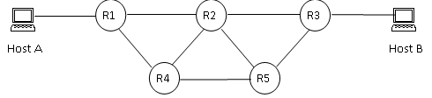
Time To Live (TTL) cont.
Suppose host A sends an IP packet to Host B
The TTL value is set to 6
If the packet goes through Host A → R1 →R2 → R3 → Host B,
Router | TTL Value
R1 R2 R3 | = 5 = 4 = 3

Slide 18
Time To Live (TTL) cont.
Suppose there is a routing problem and the packet loops through the routes R1 → R4 → R2 → R1→ R4 → R2 → R1 → R4 → R2
R1
R2
Router | TTL Value | Action
R1 | 6 -1 = 5
R4 | 5 – 1 = 4
R2 | 4 – 1 = 3
R1 | 3 – 1 = 2
R4 | 2 – 1 = 1
R2 | 1 – 1 = 0 | Discards the Packet Send ICMP message to Host A
R4
The TTL value becomes zero at router R2
Therefore IP packet is discarded

Slide 20
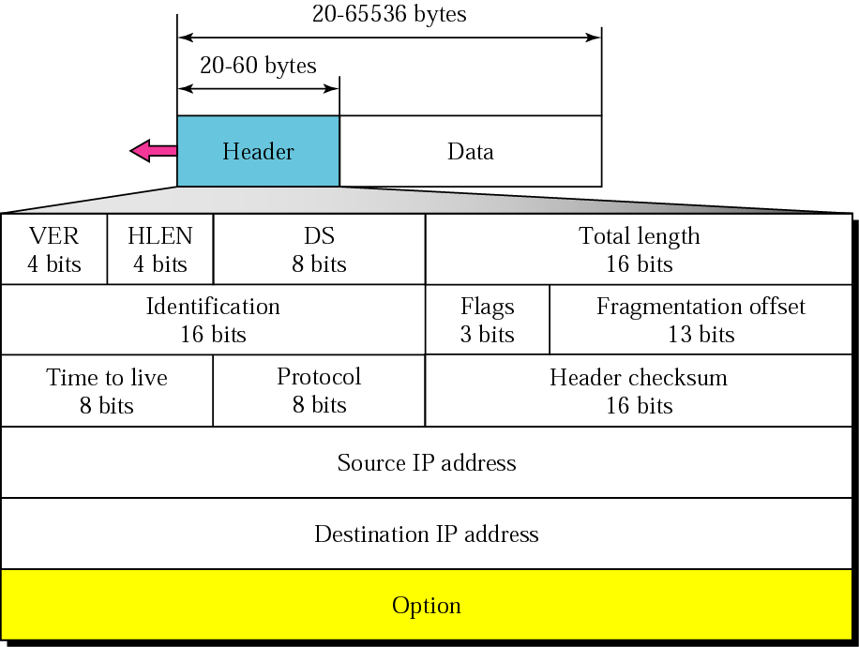
IP header
32 bits
32 bits

Slide 21
Version (VER)
A field of 4 bits
Indicates the version of the using IP addresses in the IP packet
IPv4 : 0100
IPv6 : 0110

Slide 22
Header Length (HLEN)
A 4 bit field indicates the number of 4 bytes in the header
Header size in bytes = HLEN x 4
The standard header size = 20 bytes
20 = 5 x 4
HLEN = 5 ( 0101 )2
The standard header size = 60 bytes
60 = 15 x 4
HLEN = 15 ( 1111 )2

Slide 23
Service Type
A 8 bit field
IETF has changed the name of this field as Differentiated Services
3 bits
4 bits
Precedence
TOS
Not used
Precedence defines the priority of the packet
Precedence is not used in IPv4

Slide 24
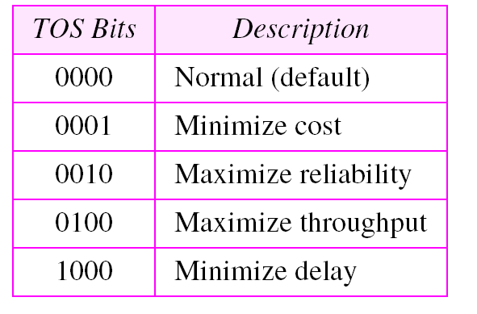
Service Type cont.
A 4-bit field
Each bit has a special meaning
There are five types of services

Slide 25
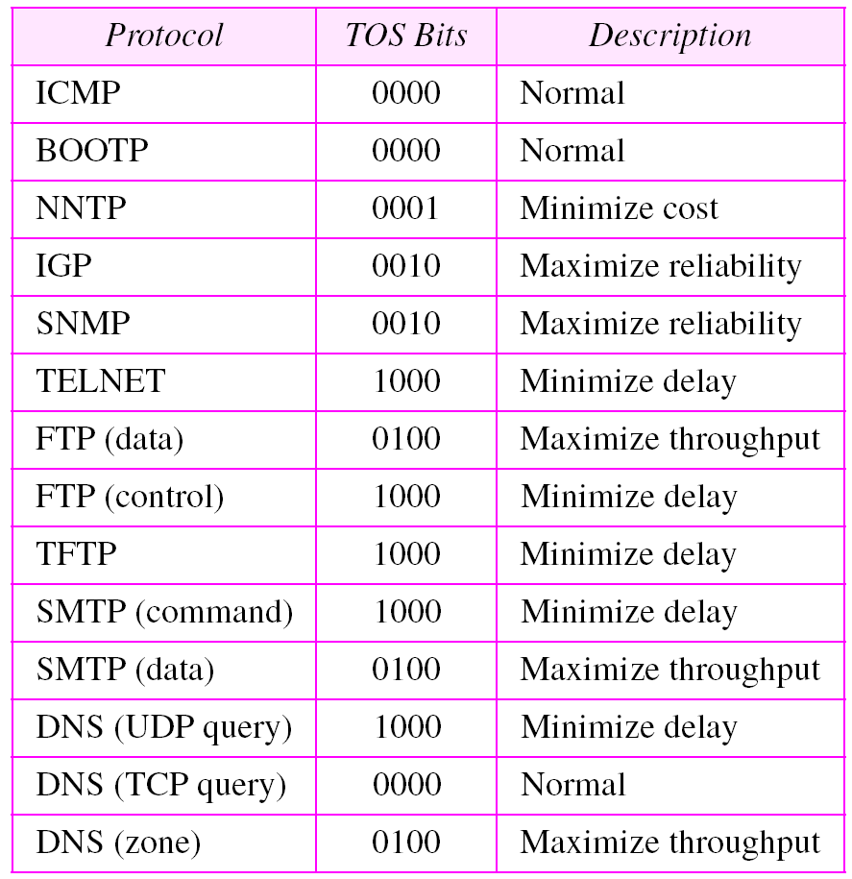
Service Type cont.
The application can select a specific type of service

Slide 26
Total length
A 16-bit field
Gives the total length of the IP packet.
Total length = data length + header length
If total length value is 300 and if this is a normal IP packet
Header length = 20 bytes
Data length = 300 – 20
= 280 bytes

Slide 27
Identification
Each IP packet is identified by a serial number called “Identification”
A 16 bit field
The identification of each fragmented IP packet is equal to identification of original IP packet

Slide 28
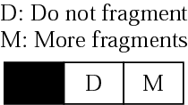
Flags
D = 1, means is not allowed to be fragmented
D = 0, means is allowed to be fragmented
M = 0, means that there are no more fragments;
The fragment is the last one.
Non fragmented packet is considered the last fragment
M = 1, The fragment is not the last one.

Slide 29
Fragmentation offset
A 13-bit field
This gives the offset value of the fragment

Slide 30
Time To Live (TTL)
A 8 bit field
Defines the maximum number of hops the packet can travel

Slide 31
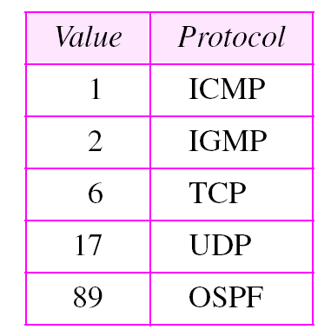
Protocol
The IP packet data can be UDP, TCP, ICMP, IGMP, EGP
Used to identify the type of data a special field called “protocol”
A a 8-bit field which defines the protocol number

Slide 32
Header Checksum
A 16-bit field
Checks the errors of the header only.
If errors are found in the header, the whole IP packet is discarded.

Slide 33
Source IP Address
A 32-bit field
This gives the IP address of the source
Destination IP Address
A 32-bit field
This gives the IP address of the destination

Slide 34
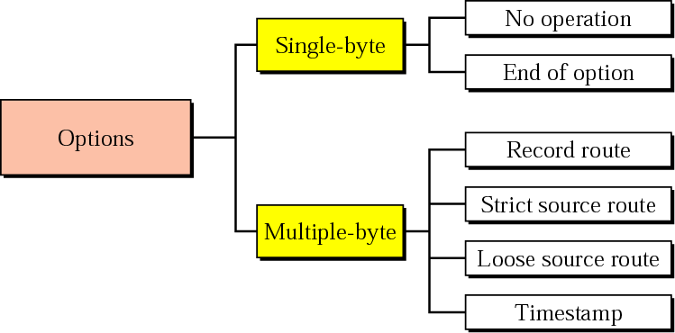
IP option

